Slide 1

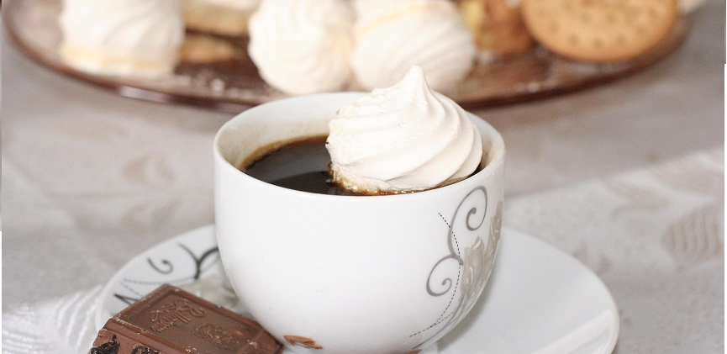
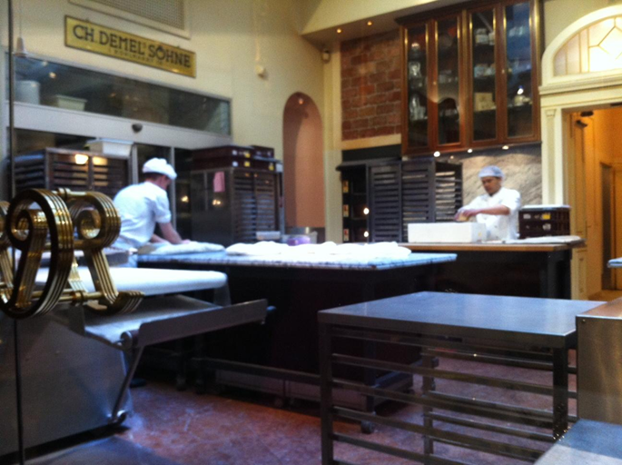
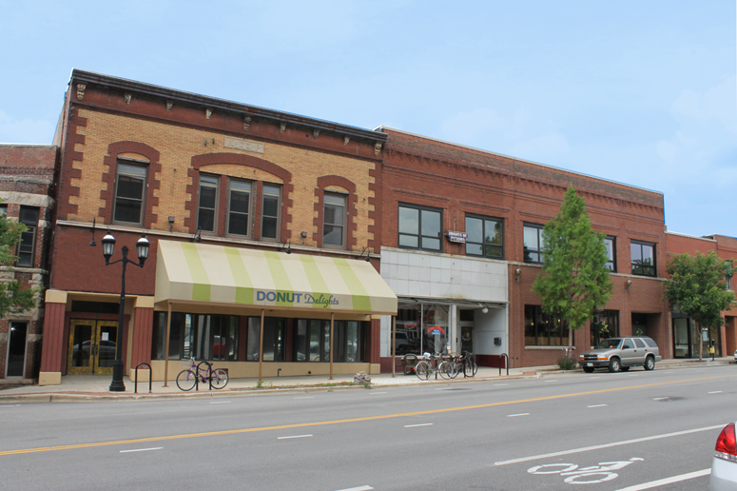

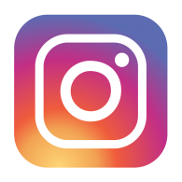

Donut Delights
Home
Menu
About Us
Location
/
Contact

Slide 2


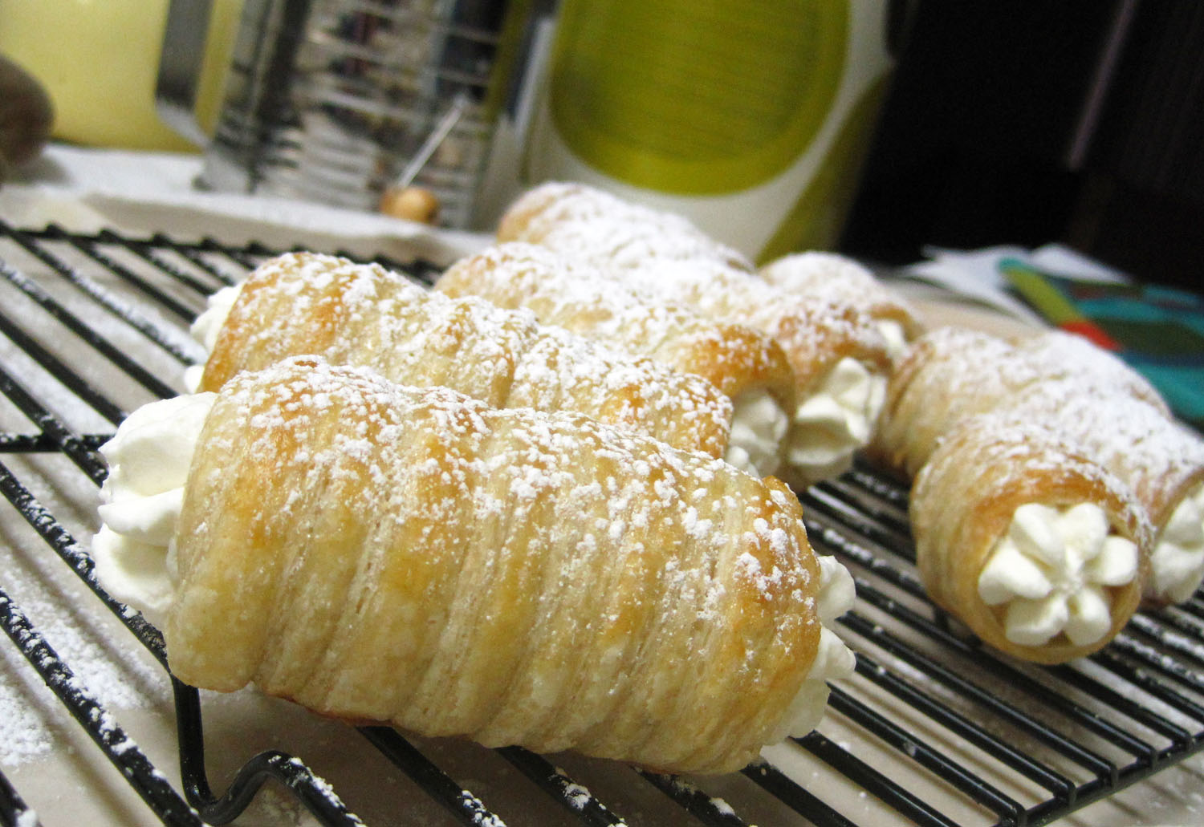
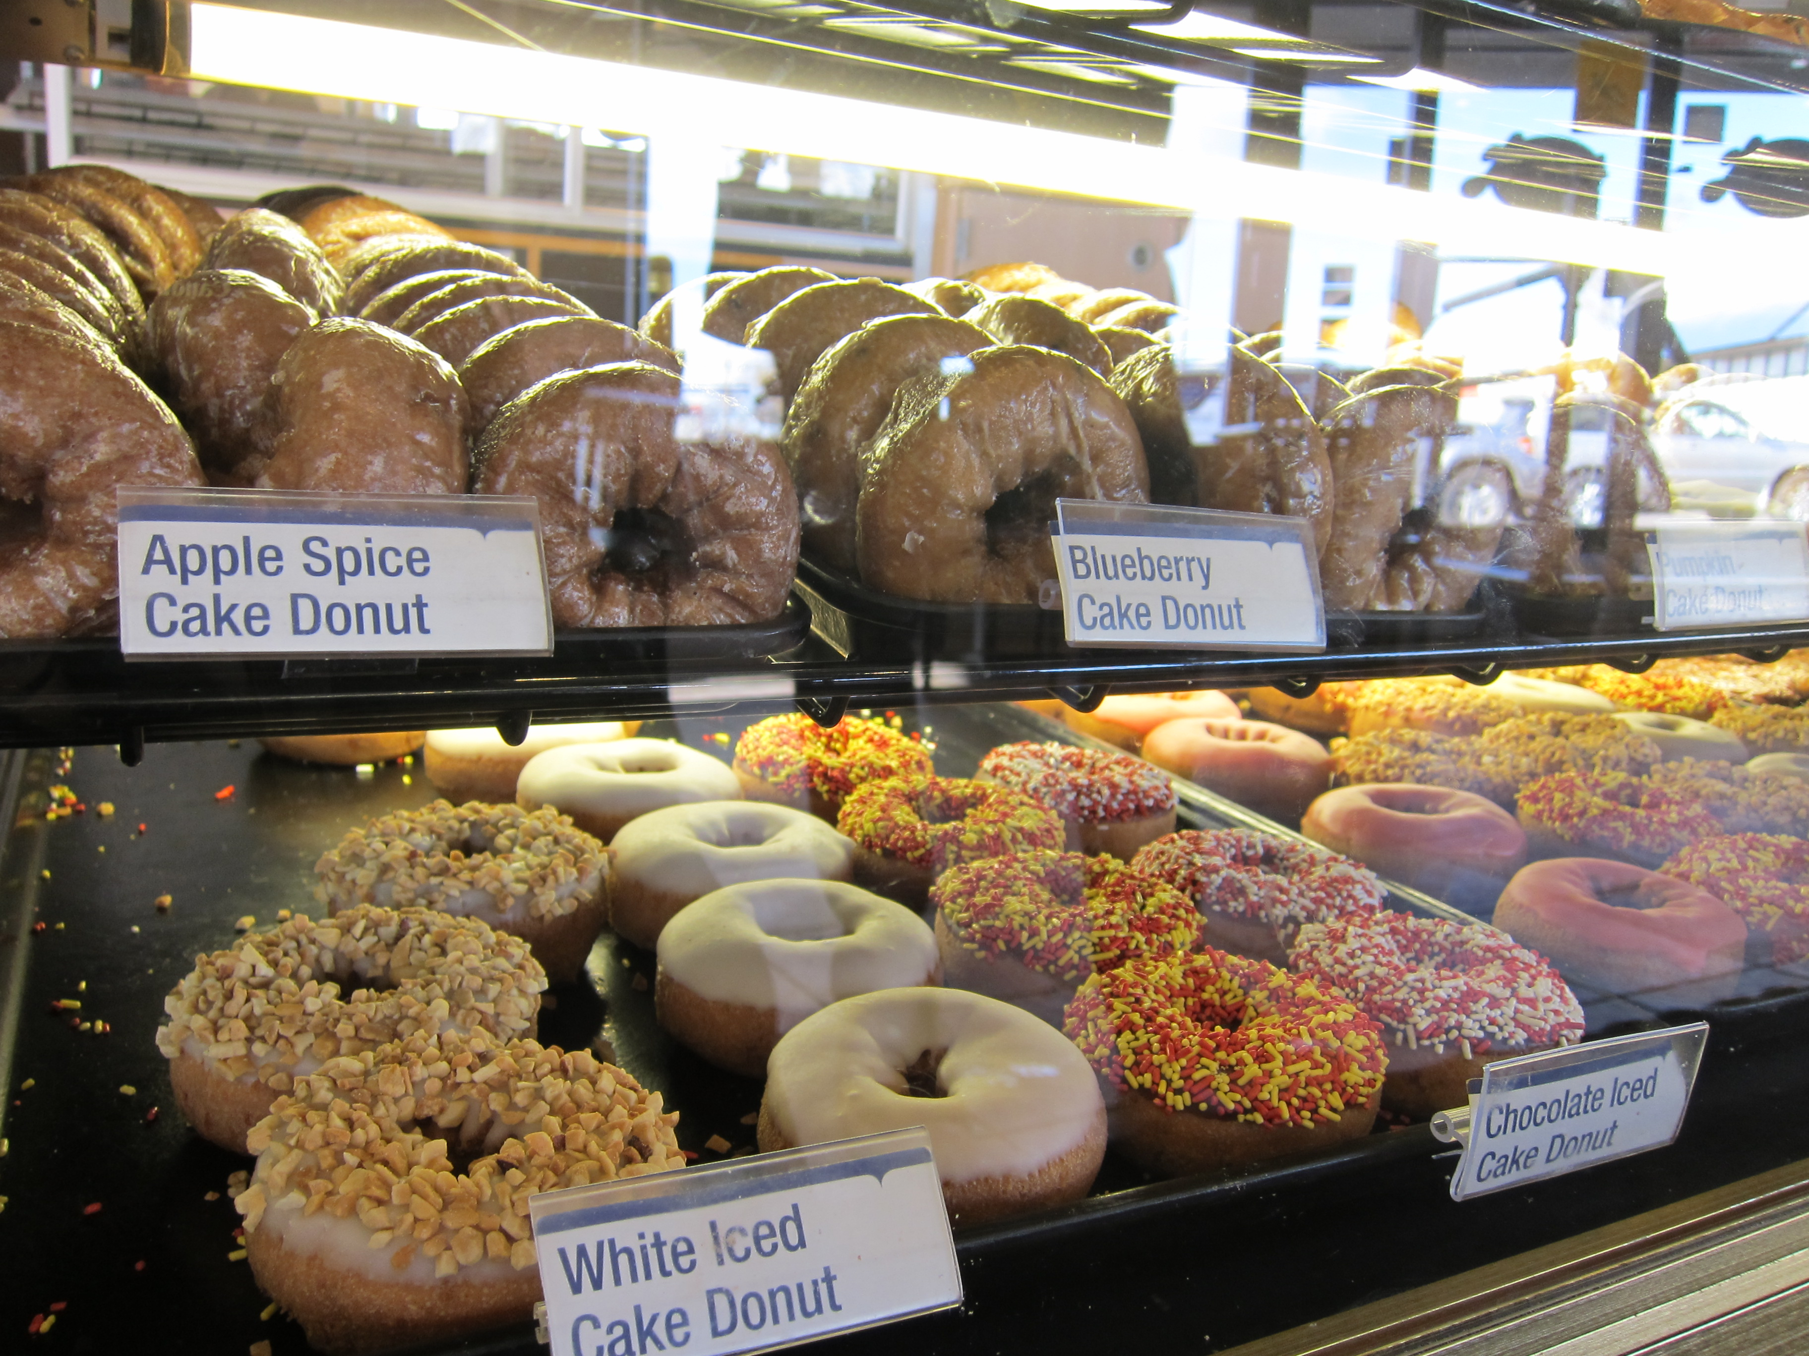
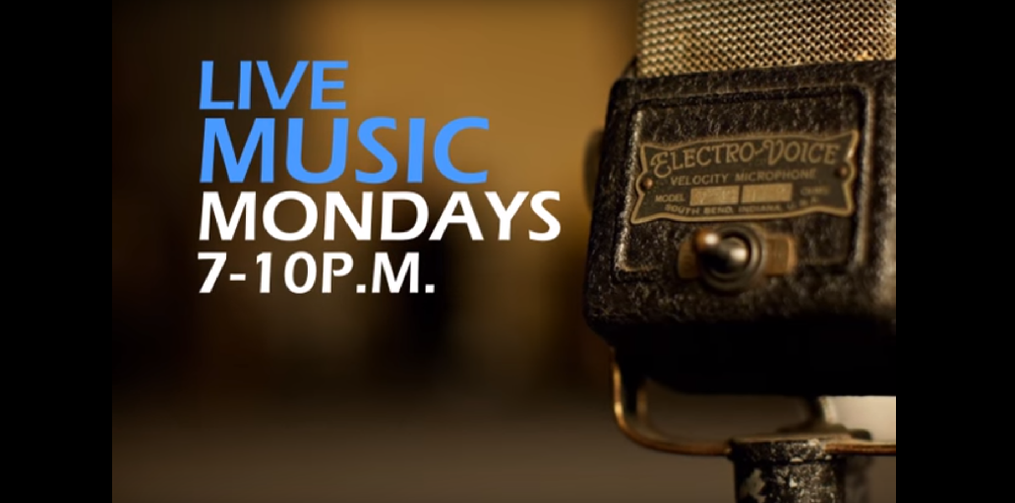
Menu
Bakers Dozen / Regular Donuts:
(13 for $8.65) (1 for $1.05)
Chocolate Frosted
Vanilla Frosted
Boston Cream
Jelly Filled
Glazed
Chocolate Glazed
Marble Twist
Sugar Raised
Plain
Plain Cruller
Honey Wheat
Jelly Puff
Cream Puff
Coffee Roll
Fancy Donuts:
(1 for $2.00)
Bow Tie
Éclair
Apple Turnover
Fancy Coffee Roll
French Cruller
Top sellers:
(1 for $3.50)
Pistachio Pinwheels
Boston Cream Delights
Chocolate Confetti
Marshmallow Mayhems
French Twists
Bulls Horns
Home
Menu
About Us
Location
/
Contact

Slide 3
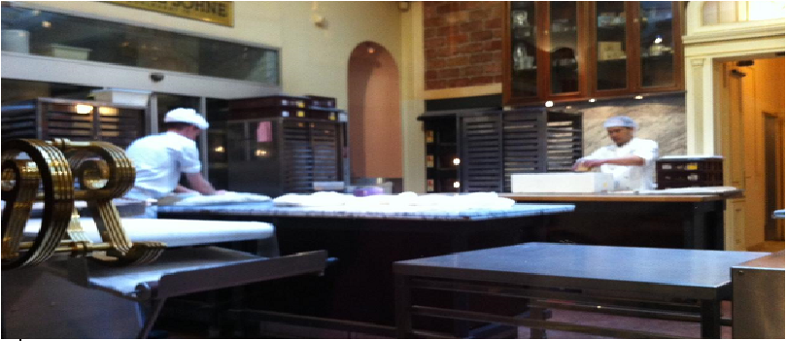
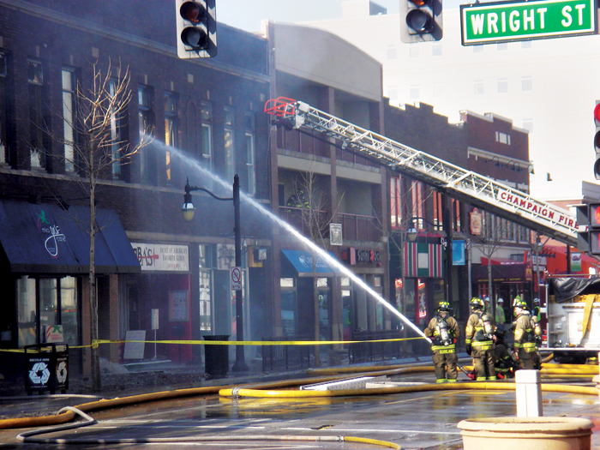
History
Donut Delights was started in 1971 by Melvin Furballski, an immigrant baker from the far east coast of Poland. Known far and wide for his delicate pastries, Melvin fled his homeland in search of a better life for his family. In 1970 he landed in New York City and by chance he found an open seat on a bus heading west. When an unexpected mechanical failure forced a three day delay in Champaign, Illinois, Furballski saw the need for a donut shop, so he decided to stay and make a new life for himself in Urbana, Illinois. With only one hundred dollars to his name, he found an abandoned bread shop and within two days he had one of a kind donuts flying off the racks faster than he could bake them and things have never slowed down. Now you can find that same great donut recipe plus dozens more still being made with the same love and care as when Donut Delights first opened. A bakery fire in the mid-1980s destroyed many of the shop's records...but NOT THE RECIPES. While many people might have viewed the fire as an excuse to quit, Melvin instead used it as an opportunity to reconfigure the interior design, allowing him to add the coffee roastery section as well. So when you visit, be prepared for the inviting mix of aromas from fresh-roasted coffee beans and fresh-baked donuts: It's the closest thing to "Breakfast Heaven" anywhere in the C-U area
Home
Menu
About Us
Location
/
Contact

Slide 4
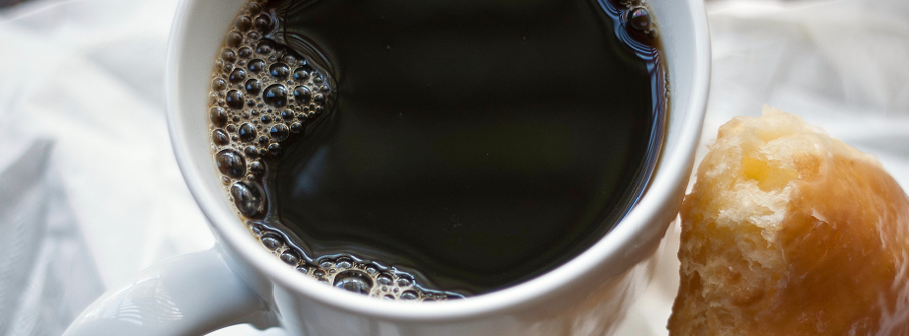
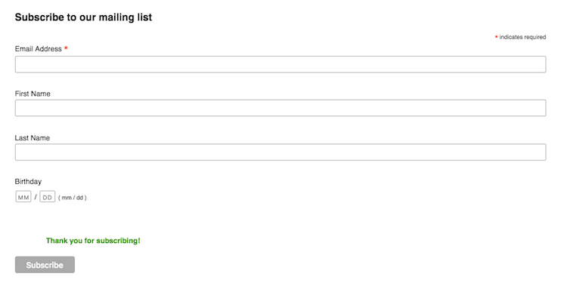
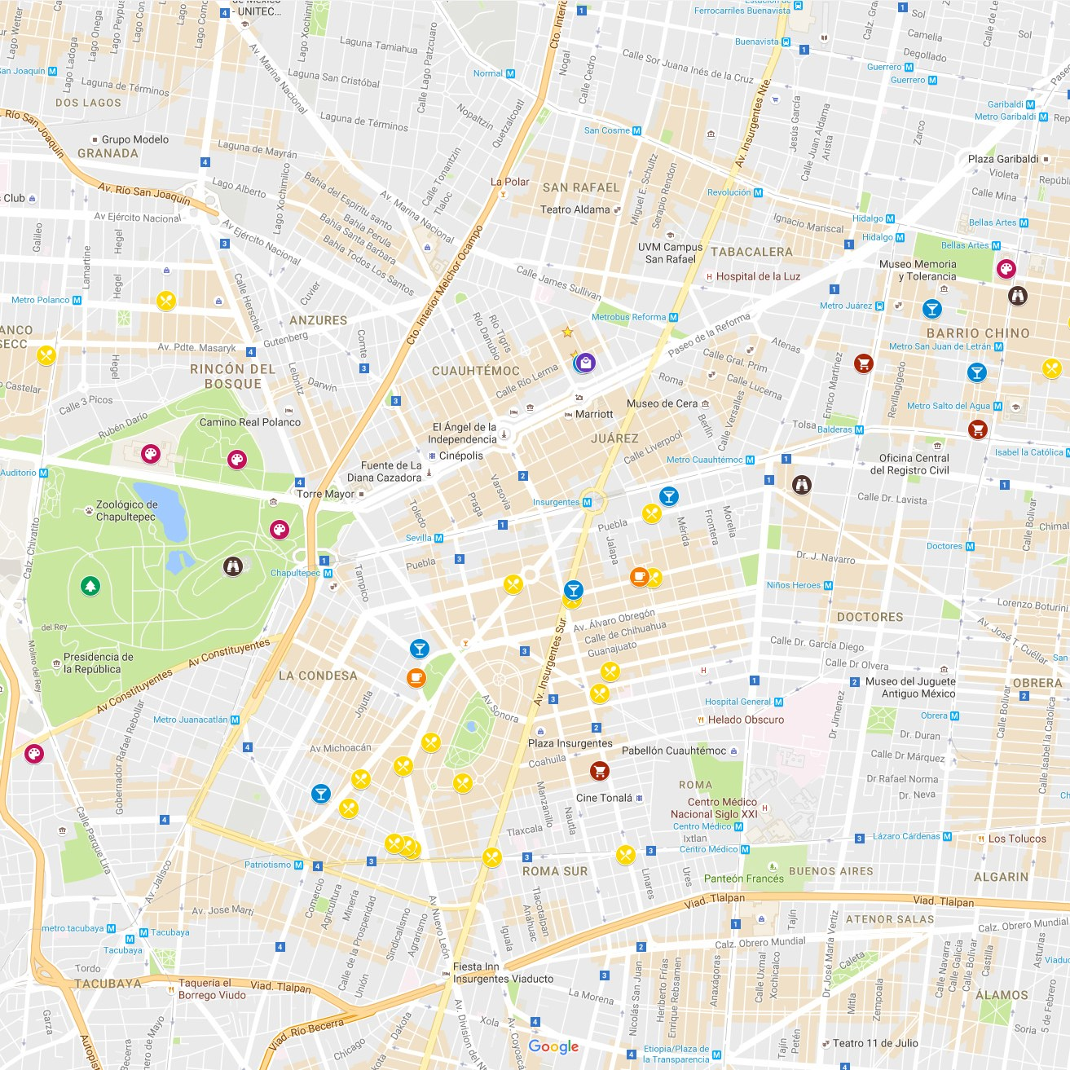
Location/Contact
Home
Menu
About Us
Location
/
Contact
2112 Main Street Urbana , Illinois 61801
(217) – 555 - 1234
Email: contact@donutdelights.com
FUN FACT
AS OF 2011, 10 PEOPLE IN THE UNITED STATES HAVE THE LAST NAME “DOUGHNUT” or “DONUT.”
Comments Area

